Slide 1
Health Insurance Portability and Accountability Act (HIPAA) and Clinical Research
Research Compliance
Notes:
The HIPAA Rule was established to improve the flow of information while protecting the privacy of patients’ Protected Health Information.
The Privacy Rule provides federal protections for personal health information held by covered entities and gives patients an array of rights with respect to that information. At the same time, the Privacy Rule is balanced so that it permits the disclosure of personal health information needed for patient care and other important purposes.
This confidential information is stored and shared by:
Verbal Communication
Paper documents
Electronic data

Slide 2
Protected Health Information (PHI)
Unique Identifiers include:
Names
Geographic subdivisions smaller than a state
All elements of dates
Telephone numbers
Fax numbers
Electronic mail addresses
Social security numbers
Medical Record Numbers
Health Plan beneficiary numbers
Account Numbers
Certificate/license number
Vehicle identifiers & serial numbers.
Device identifiers and serial numbers
Web Universal Resource Locators (URLs)
Internet Protocol (IP) address numbers
Biometric identifiers, including finger and voice prints
Full face photographic images and any comparable image
Any other unique identifying number, characteristic, or code
**Please be aware that individual subjects may be identifiable by combining other data elements even when none of the 18 identifiers are present.
Notes:
There are 18 Identifiers that are protected by the HIPAA Rule. Information in any format that identifies the individual, including demographic information collected from an individual that can reasonably be used to identify the individual.
Example: A study may contain personal identifiable data even after removing or never acquiring the identifiers listed. That is why it is imperative to complete detailed information from a data security standpoint to the Institutional Review Board (IRB).

Slide 3
Research: Informed Consent
Research Subjects have the right to decide how their information is used or shared. They do this by signing an authorization.
An Investigator may not involve a human being as a subject in research unless a legally effective informed consent from the subject or the subject’s legally authorized representative is obtained. Standards include:
Information-information should be sufficient so that a “reasonable volunteer” can decide whether to participate in a research study.
Comprehension- Information should be provided to potential subjects in such a way that they can understand what is being conveyed.
Voluntariness – An agreement to participate in research constitutes a valid consent only if voluntarily given.
“Respect for persons requires that subjects, to the degree that they are capable, be given the opportunity to choose what shall or shall not happen to them. This opportunity is provided when adequate standards for the Informed Consent are satisfied.” (National Commission 1979)
Notes:
Research Subjects have the right to decide how their information is used or shared. They do this by signing an authorization. However, there are circumstances, such as, treatment, payment, and operations- for which HIPAA otherwise allows information to flow without an authorization.
An Investigator may not involve a human being as a subject in research unless a legally effective informed consent from the subject or the subject’s legally authorized representative is obtained. Standards include:
Information-information should be sufficient so that a “reasonable volunteer” can decide whether to participate in a research study.
Comprehension- Information should be provided to potential subjects in such a way that they can understand what is being conveyed.
Voluntariness – An agreement to participate in research constitutes a valid consent only if voluntarily given.
Respect for persons also involves respecting an individuals right to privacy, the right to control access to ones self and information, and protecting the confidentiality of private, identifiable information about individuals.
Informed Consent is required for participation in FDA-related clinical investigations except under limited circumstances as described in 21 CFR 50.23 (involving certain life threatening situations, military operations, or public health emergencies, and 21 CFR 50.24 (involving emergency research)

Slide 4
No research involving uses and disclosure of a research subject’s PHI may be conducted unless one of the following applies:
An authorizations for use or disclosure of such information is obtained by subject or the subjects legal guardian.
A waiver of authorization has been approved by one of the UT IRB pursuant to 45 CFR 164.512 (i) or approved by a privacy board.
The research involves no more than minimal risk to the subjects
The waiver or alteration does not adversely affect the rights and welfare of the subjects
The research could not practicably by carried out without the waiver or alteration; and
Whenever appropriate, the subjects will be provided with additional pertinent information after participation.

Slide 5
TIPS when using the Electronic Medical Record System (Sunrise EMR)
General Rules:
Don’t share your unique password with others
Do not access PHI of family, friends, staff, or any other person
Do not leave your workstation unlocked
Notes:
UHS has password restrictions to aid towards a unique password that cannot be easily identified.
Do not share your password, as this is a UHS policy violation, and to access information that does not pertain to your job is a HIPAA Privacy Rule violation. Any and all access that occurs by your log in name, you are still held accountability for.
It is crucial to only access information you need to do your job, and only share information with others that need it do their job.
Do not access the PHI of family or friends, there must be a valid authorization on file that supports access to PHI. (Visit the Medical Records Dept. to obtain applicable consent form)
Do not leave your work station unlocked (If you are held accountable for all access under your unique username

Slide 6
Emailing PHI
As a general rule, email should not be used to communicate PHI. Email is inherently less secure than other forms of communication. However, email of PHI will be permitted if certain safeguards are implemented.
Email communications containing PHI will be transmitted only on the Health System’s email system and cannot be forward to an email account outside the Health System unless you comply with the requirements:
PHI when sent from UHS email (@uhs-sa.com) to an external email must enter PHI: on the subject line. (semicolon after PHI must be included in order for encryption).
PHI will not be transmitted in the subject line of the email message
The fact that the message or an attachment to the message containing PHI will be reflected in the subject line of the email message
Before transmitting email with PHI, users will verify the message content and attachments to ensure that it is for the intended receiver and no unintended information is included
Users who communicate PHI via email will comply with the Minimum Necessary standard
** If emailing from an UTHSCSA.edu email address, you must comply with HIPAA, UTHSCSA, and UHS policies. To encrypt using UTHSCSA email, you will enter, ++ on the subject line of the email containing PHI.
Notes:
All e-mail will automatically include the Health System’s standard confidentiality notice.
If an email containing PHI is received in error (either internally or externally), the sender must be notified immediately by email incident and the incident report must be completed and submitted to the UHS HIPAA Privacy Officer, Sherry Johnson. The Privacy Officer’s contact information will be listed at the end of the presentation.

Slide 7
Texting PHI
Texting can offer providers numerous advantages for clinical care. It may be the fastest and most efficient means of sending information, because of these advantages physicians may utilize texting clinical information, authorized or not.
Text messages may reside on a mobile device indefinitely, where the information can be exposed to unauthorized third parties due to theft, loss, or recycling of the device.
If text messages are used to make decisions about patient care, then they may be subject to the rights of access and amendment. There is a risk of non-compliance with the privacy rule if the covered entity (UHS or UTHSCSA) cannot provide patients with access to or amend such text messages.
Please be mindful that PHI in any medium is subject for the HIPAA Privacy Rule.
Notes:
Text messaging merely represents a different set of risks that, like other communication technologies, needs to be managed appropriately to ensure both privacy and security of the information exchanged.
Texting can offer providers numerous advantages for clinical care. It may be the fastest and most efficient means of sending information in a given situation, especially with factors such as background noise, spotty wireless network coverage, lack of access to a desktop or laptop, and a flood of clogging inboxes. Because of these advantages physician's may utilize texting to communicate clinical information, whether authorized or not.
Text messages may reside on a mobile device indefinitely, where the information can be exposed to unauthorized third parties due to theft, loss, or recycling of the device.
**Texts also may be temporarily maintained on a telecommunications providers servers while the message awaits delivery to the recipient’s device (if the recipient's device is powered off or out of range). Texts primarily will be transmitted through the wireless cellular networks

Slide 8
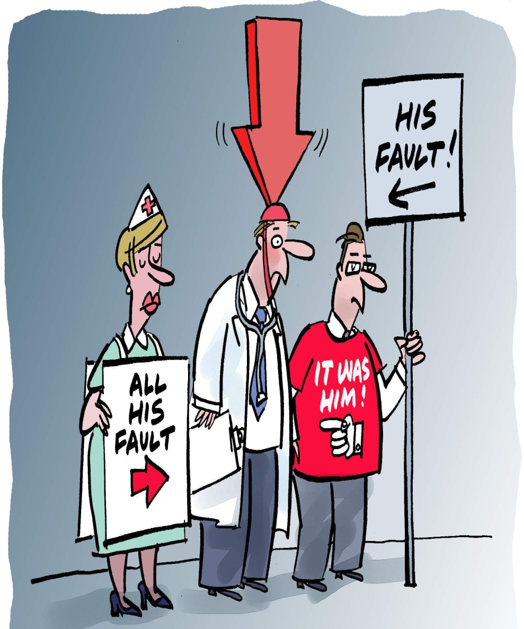
Common Findings in Research Studies
Protocol non-adherence
Inadequate and inaccurate records
Failure to report adverse events or UPIRSOs
Failure to report concomitant therapy
Inadequate drug/device accountability
Lack of training/qualifications records
Informed consent issues
IRB problems
Used with permission from Don Mayne. Wretched Mess Research Cartoons(2009)
Notes:
There are several common findings that have been brought to the forefront, through retroactive audits, risks assessments, etc. Through education and ensuring one is making efforts to ensure compliance is met regarding protected health information and research studies we can reduce the common findings.

Slide 9
HHS Case Study
Private Practice Revises Policies and Procedures Addressing Activities Preparatory to Research Issue: Impermissible Disclosure-Research
A private practice physician who was the principal investigator of a clinical research study disclosed a list of patients and diagnostic codes to a contract research organization to telephone patients for recruitment purposes. The disclosure was not consistent with documents approved by the Institutional Review Board (IRB). The private practice maintained that the disclosure to the contract research organization was permissible as a review preparatory to research. Activities considered “preparatory to research” include: preparing a research protocol; developing a research hypothesis; and identifying prospective research participants. Contacting individuals to participate in a research study is a use or disclosure of protected health information (PHI) for recruitment, as it is part of the research and is not an activity preparatory to research.
Mitigation:
To remedy this situation, the private practice revised its policies and procedures regarding the disclosure of PHI and trained all physicians and staff members on the new policies and procedures. Under the revised policies and procedures, the practice may use and disclose PHI for research purposes, including recruitment, only if a valid authorization is obtained from each individual or if the covered entity obtains documentation that an alteration to or a waiver of the authorization requirement has been approved by an IRB or a Privacy Board.

Slide 10
Research Misconduct
Please remember:
Inappropriate access is punishable by federal and state law
UHS monitors chart access proactively by using the auditing tool,
Possible Outcomes if Research Study is Audited
Protocol suspension by local administration
Investigator disqualification
Administrative action
Funding revocation/ ineligibility for new funding application
For FDA-regulated research:
FDA483 form,
Warning letter,
Notice of Disqualification Proceeding,
Rejection of the study data/ entire study,
Prosecution
Notes:
The Health System is committed to conducting all of its research activities with integrity, adhering to both scientific and ethical principles. Any actual, potential, or suspected misconduct must be reported to the Health System’s Privacy Officer, or the 24 hour hotline number.
UHS believes in the importance of protecting whistleblowers. The Health System will not tolerate or engage in retaliation again good faith whistleblowers.

Slide 11
UHS Privacy Officer
Feel free to contact the Privacy Officer by phone, e-mail, or by the anonymous integrity hotline available 24 hours a day, 7 days a week, with any questions or concerns about HIPAA requirements or regulations; or to report a HIPAA violation.
Sherry Johnson Vice President, Integrity & Regulatory Service, Privacy Officer Sherry.Johnson@uhs-sa.com Phone: (210)743-6541
OR
Please also feel free to contact me, Tiffany Mince, Assistant Director of Research Compliance at Tiffany.Mince@uhs-sa.com or call me at (210)743-6453.
Notes:
University Health System is committed to protecting patient privacy and complying with HIPAA laws. When a staff member (discloses) provides a patient with another patient’s personal health information (PHI), the error is a wrongful disclosure. The Health System is required by HIPAA laws to mitigate, the risk of any harmful effects of the error. Harmful effects could result in a breach of PHI or even identify theft.
Any actual, potential, or suspected misconduct must be reported to the Health System’s Privacy Officer, or the 24 hour hotline number.

